Slide 1




Data Persistence
Session 7
Mobile Community Solution

Slide 2



Learning Outcome
Android Concept
and Java Language
UI Component
and Main Features
Demonstrate
and Construct an App

Slide 3
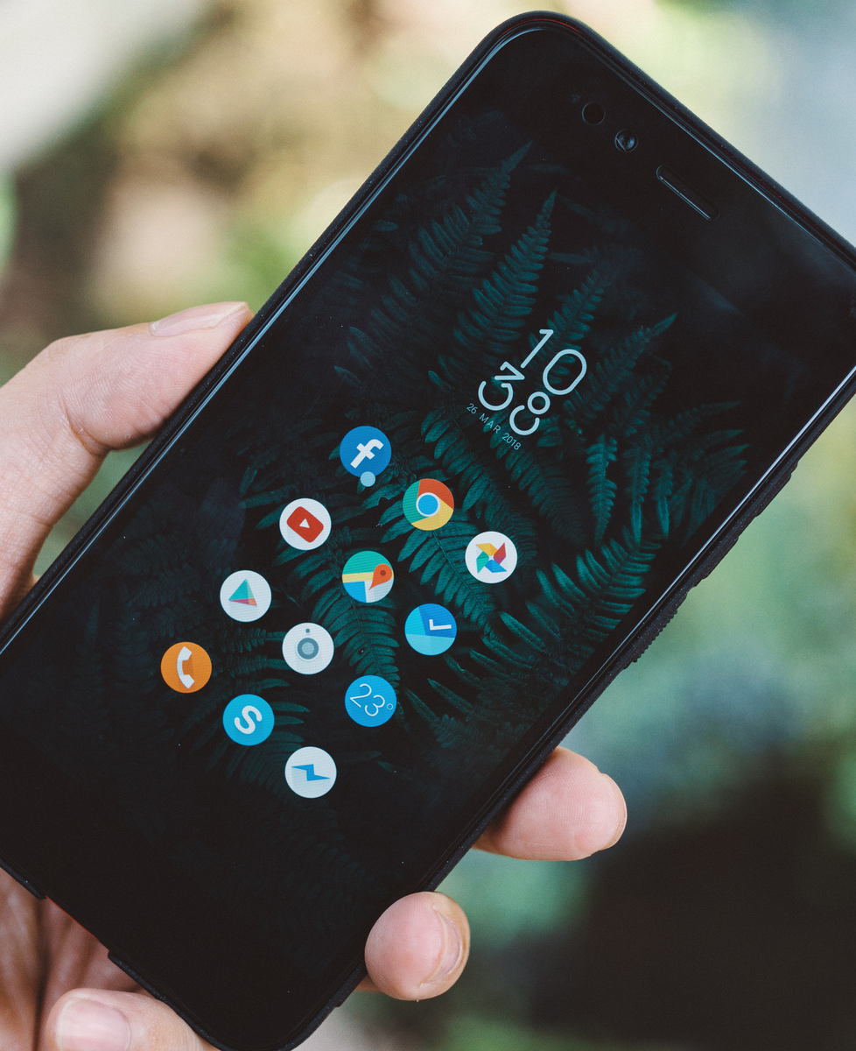
Today's
Session
Persisting Data to File
Saving to Device Storage
Using SQLite

Slide 4

Persisting Data
There are several options to save persistent application data:
Shared Preferences
Internal Storage
External Storage
SQLite Databases
Network Connection
Notes:
- Shared Preferences Store private primitive data in key-value pairs.
- Internal Storage Store private data on the device memory.
- External Storage Store public data on the shared external storage.
- SQLite Databases Store structured data in a private database.
- Network Connection Store data on the web with your own network server.

Slide 5
Shared Preferences
Used to store and retrieve primitive information.
The data stored in key-value pair.
Primitive information includes:
Int
Boolean
Float
Double
Char

Slide 6
Shared Preferences
Case Example:
Change apps language.
Storing login credential.
Storing app settings.

Slide 7
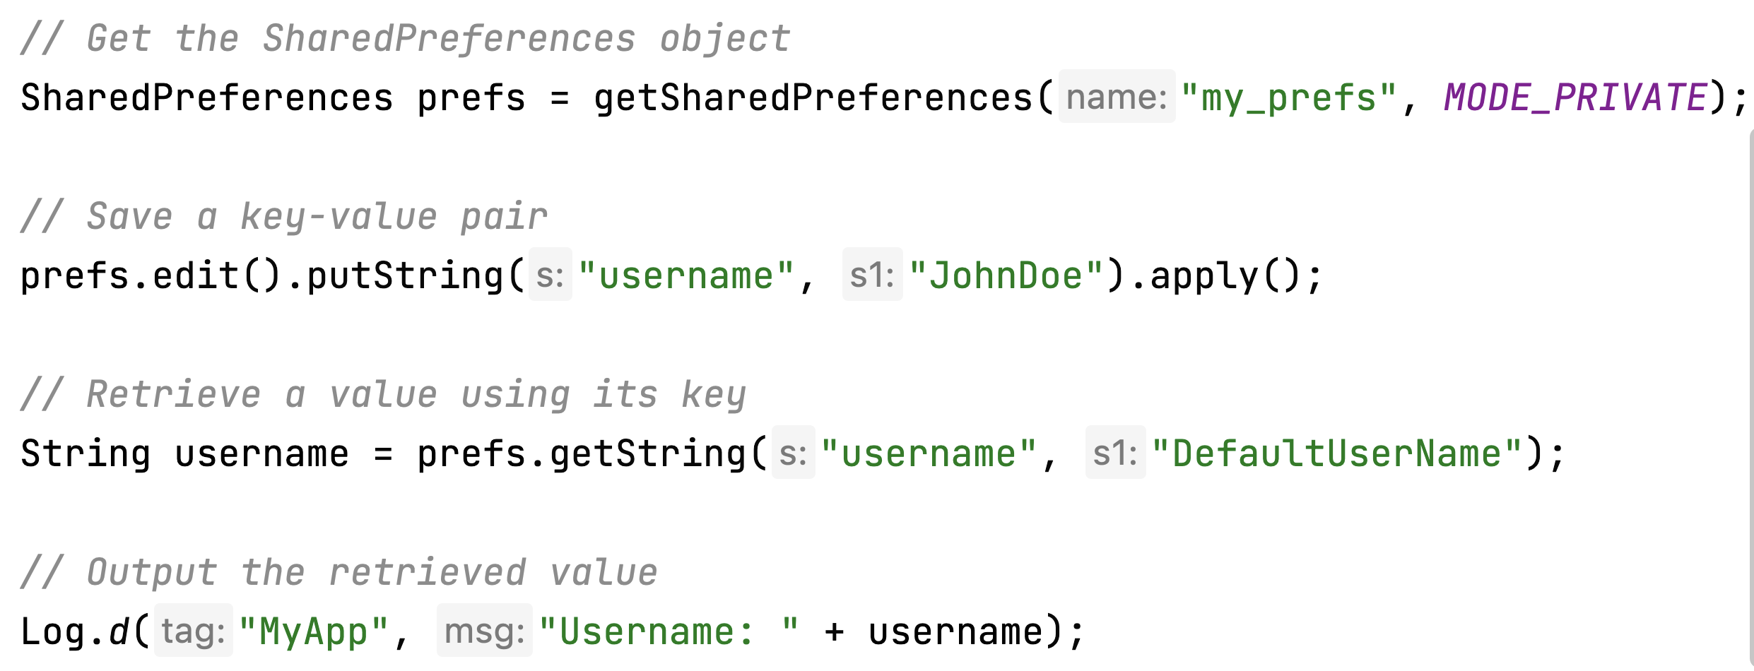
To Use Shared Preferences

Slide 8
File Access Mode
MODE_PRIVATE -> can only be access by the app that created it.
MODE_WORLD_READABLE (17) -> allow other app to read but not to write.
MODE_WORLD_WRITEABLE (17) -> allow other app to read and write.
MODE_MULTI_PROCESS (23) -> multiple process access the same file.
MODE_APPEND -> allow new data to be appended to existing data.

Slide 9
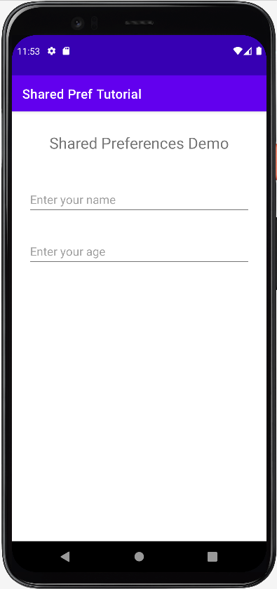
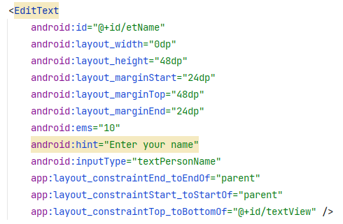
Example
Create the Edit Text for user input

Slide 10
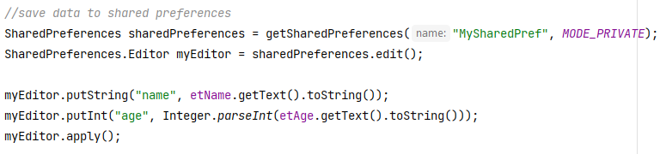
Example
Save data to shared preferences
Notes:
Add in onCreate / onPaused

Slide 11
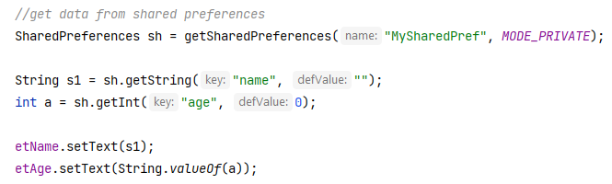
Example
Load data from shared preferences
Notes:
Add in onResume

Slide 12
Save to Internal Storage
Android enabled the developer to save and read data from device internal memory.
FileOutputStream is used to save data into file.
FileInputStream is used to read data from file.
When user uninstalls the application, these files are also removed.
Since Android 10, the file can only be accessed from the respective app.

Slide 13
Save to Internal Storage
Example:
Notepad app.
Music streaming app.
Cache downloaded files.

Slide 14
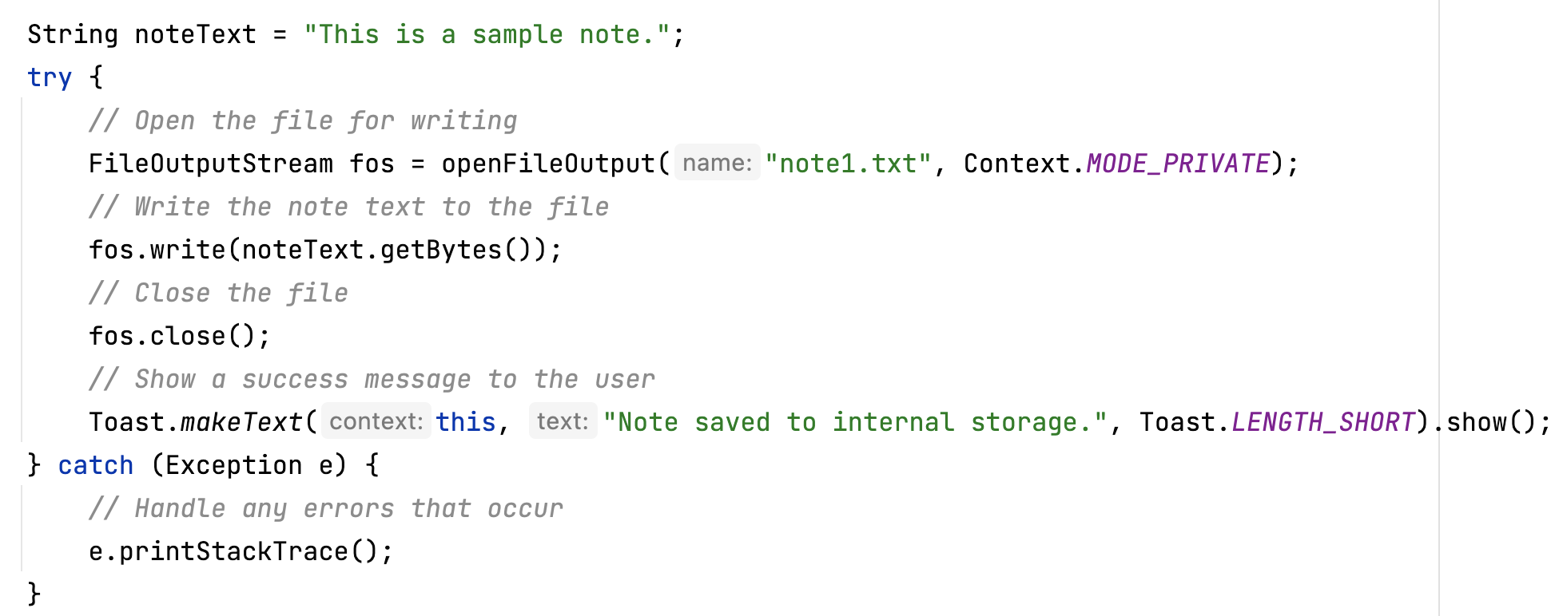
To Store a File

Slide 15
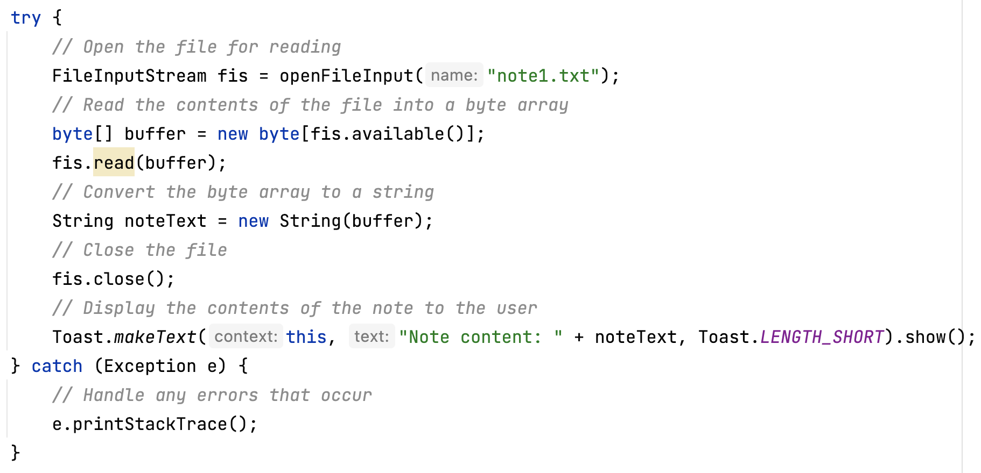
To Read a File

Slide 16
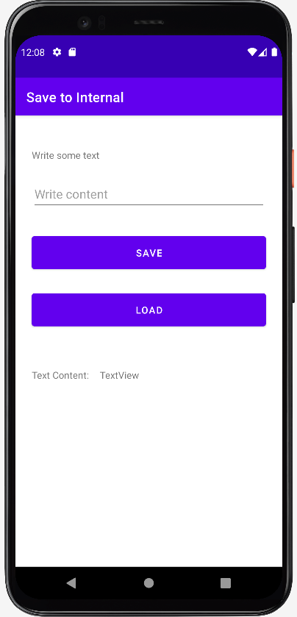
Example
Create EditText for user input and set two Buttons for Save and Load.

Slide 17
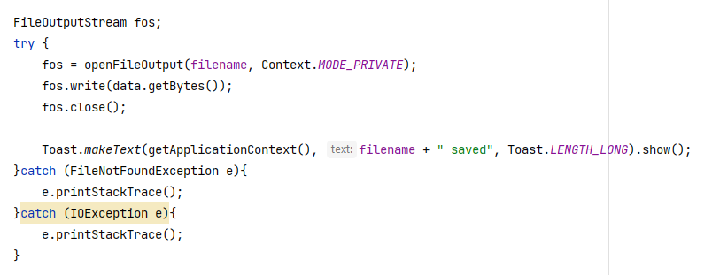
Example
Handle save by using openFileOutput and write()

Slide 18
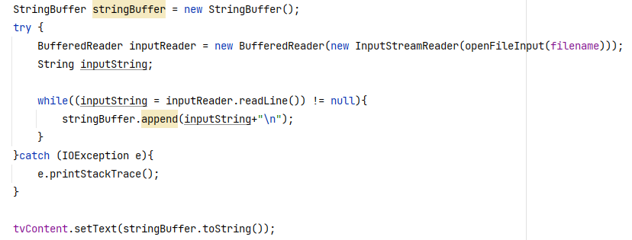
Example
Handle load data by using openFileInput

Slide 19
Save to External Storage
In Legacy version of Android (bellow 10), android enabled the external storage (sdcard) to used as external storage for the file.
Since Android 10, user can still use requestLegacyExternalStorage() to use external storage.
But in Android 11, to further enhances protection of the data. The External Storage is deprecated.
Source: https://developer.android.com/about/versions/11/privacy/storage

Slide 20
The Databases
All previous method are useful for saving simple sets of data.
For saving relational data, using a database is much more efficient.
In Android, SQLite is used as database system.
The database is only accessible by the app itself; other application will not be able to see or access it.

Slide 21
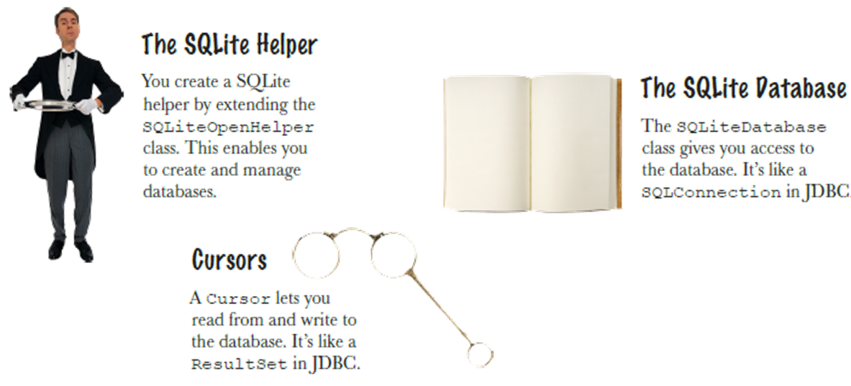
The SQLite Classes

Slide 22
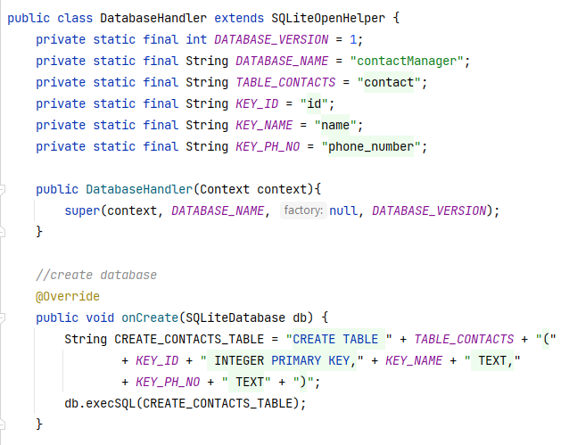
Creating and Using Databases
Create a class extends SQLiteOpenHelper.
To write the database, simply create the query and call db.execSQL() to run the query.

Slide 23
Creating and Using Databases
For complex queries, SQLiteQueryBuilder should be used. It's provides several convenient methods for building queries.
A Cursor is return from every SQLite query that point to all the rows found by the query.
The Cursor is the only mechanism to navigate results from a database query and read rows and columns.

Slide 24
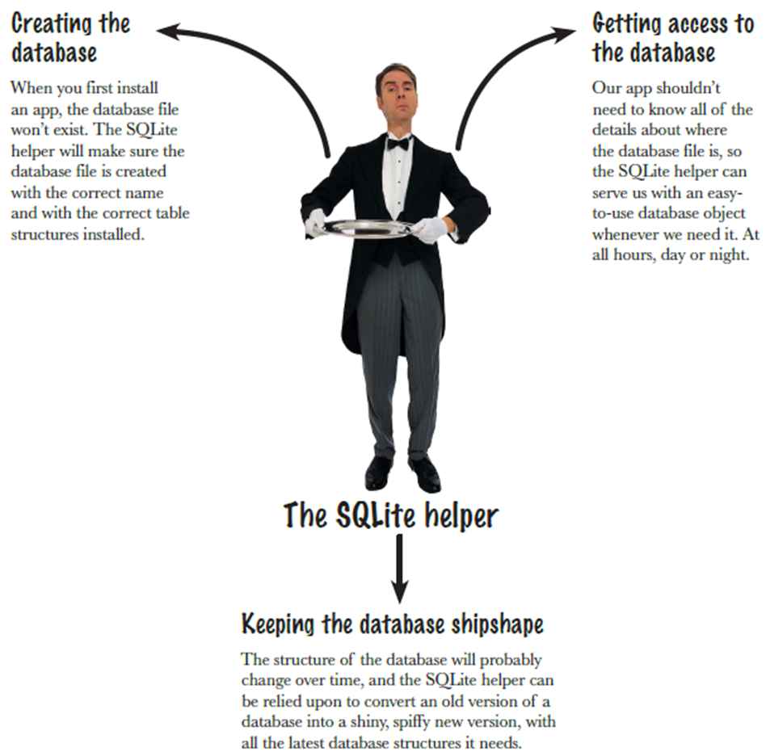
SQLite Helper,
Your Personal Assitant

Slide 25
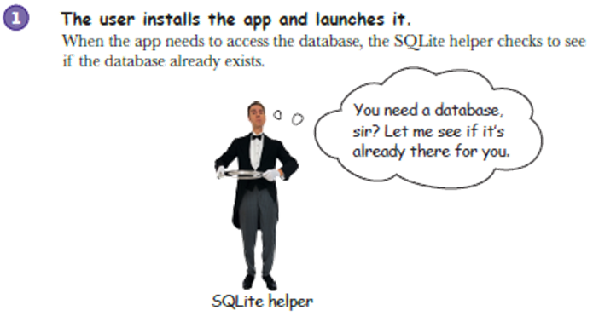
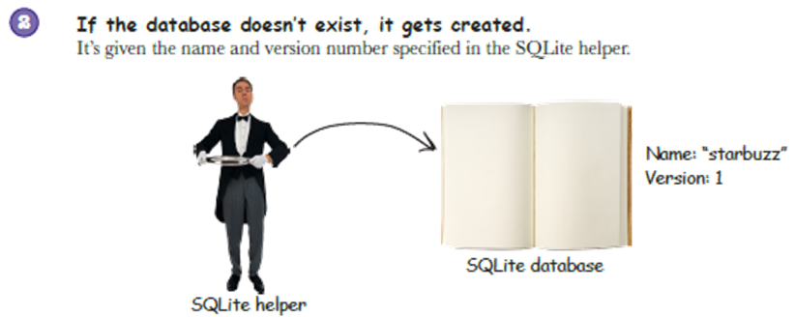
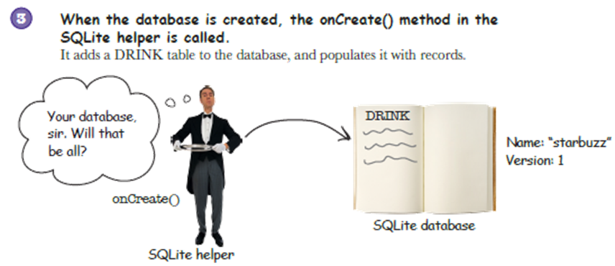
How It Works

Slide 26
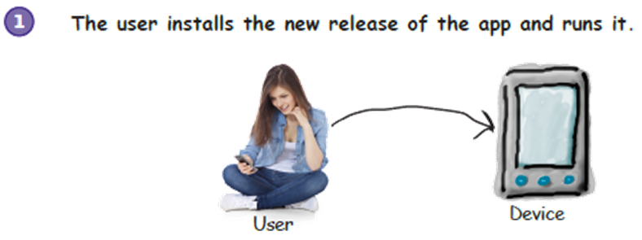
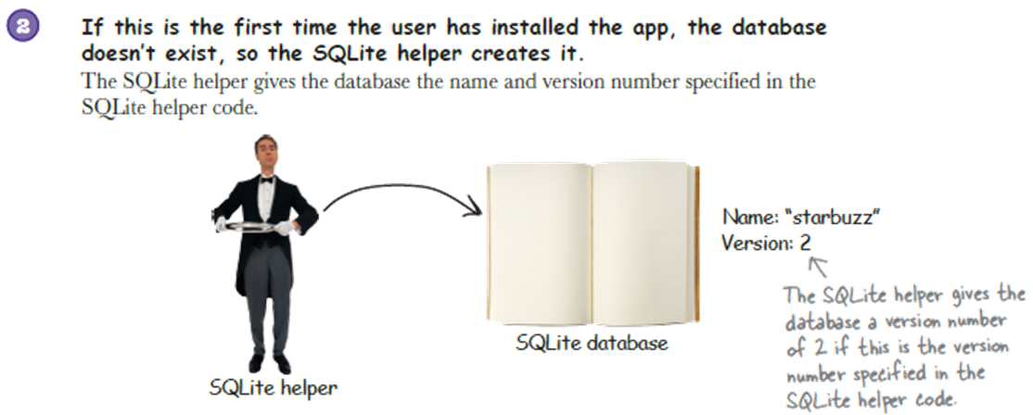
Upgrading the Database

Slide 27
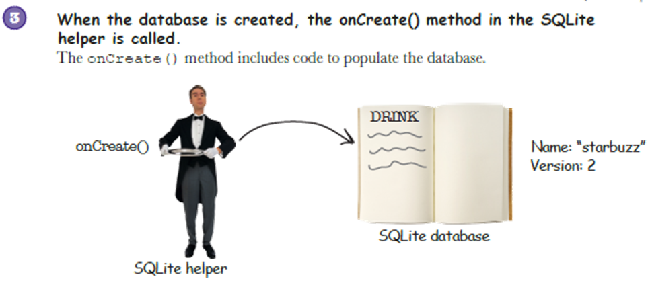
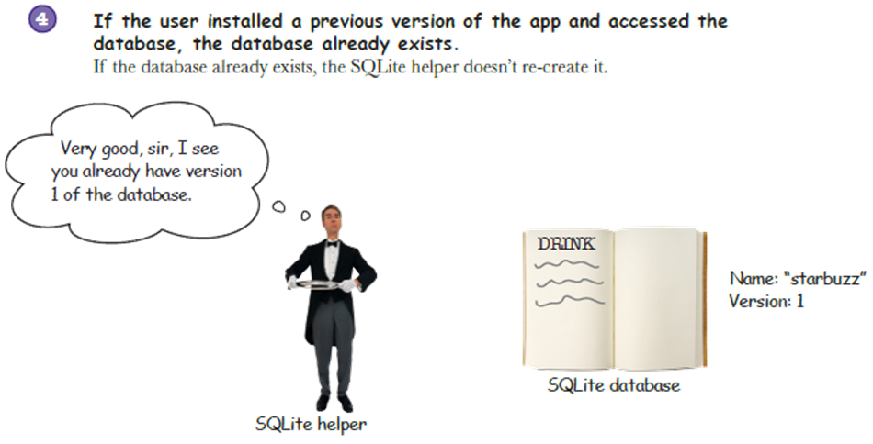
Upgrading the Database

Slide 28
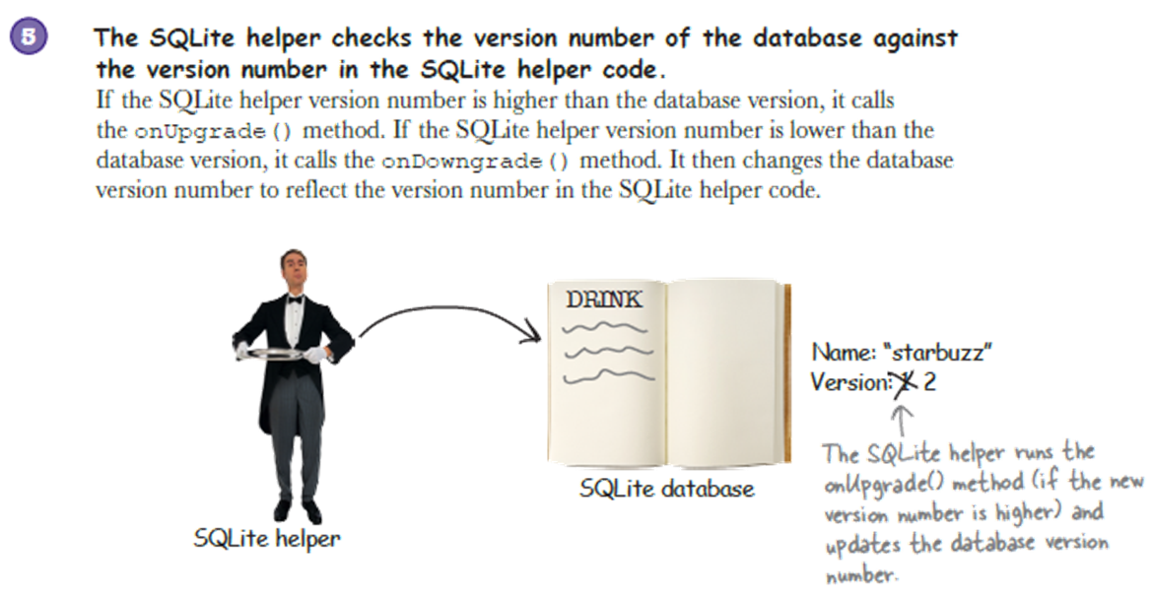
Upgrading the Database

Slide 29
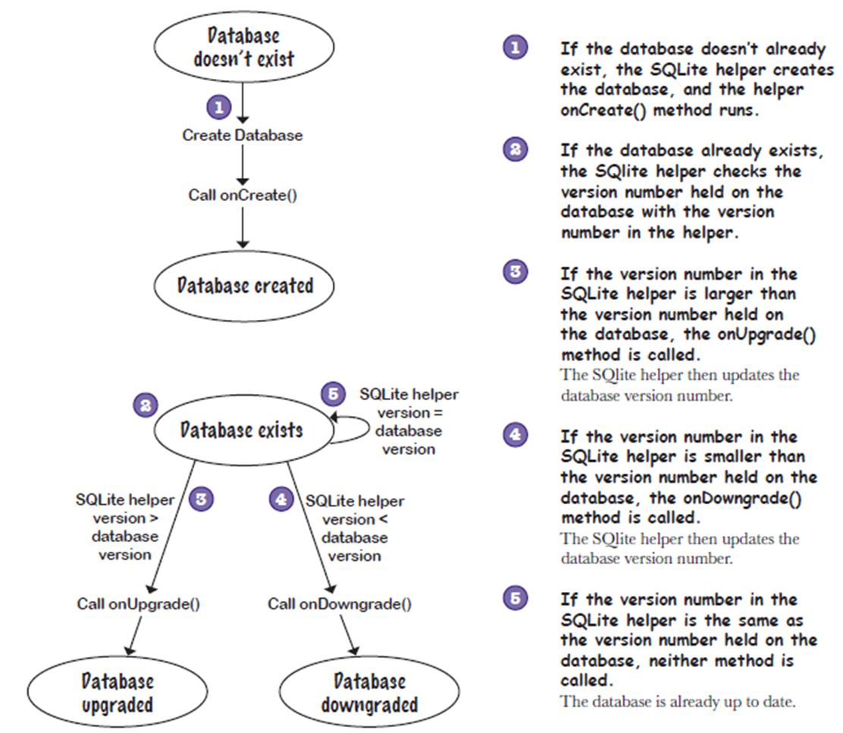
Deciding to Upgrade or Downgrade

Slide 30
Demo

Slide 31
References
Head First Android Development. A Brain friendy guide. Dawn Griffiths and David Griffiths.O’reilly. ISBN:978-1-449-36218-8. Chapter 11
https://www.javatpoint.com/android-preferences-example
https://www.javatpoint.com/android-internal-storage-example
https://www.javatpoint.com/android-sqlite-tutorial

